Slide 1
Practicing Project phase - 1
Friend Recommendation Algorithm
G. Aswin : 1RN19CS048
Abhijna Shetty :1RN19CS002
Github Link to the Project

Slide 2
Introduction- relevance of the topic
Every social media/social networking platform uses an internal graph to store the data of their users.
Users are represented by nodes and edges between them signifies a connection.
Facebook uses an undirected graph – both users are always friends with each other, whereas twitter and Instagram uses a di-graph as in – a user can follow someone without the other person following back.

Slide 3
Introduction- continued
Recommendation algorithms are extremely important because companies try to recommend what we as users are most likely to click/watch.
Lots of data is used to try to predict what exactly needs to be presented to us next.
In this project we have tried to simulate a small part of it by creating and managing a graph of users and an algorithm to recommend future connections to users.

Slide 4
problem statement
To simulate a social networking platform by using graph concepts for storing users and apply simple graph algorithms for friend recommendation.

Slide 5
Technological Requirements
Software Requirement-
TOOLS USED:
VS CODE FOR EDITING
ONLINE GDB COMPILER FOR EDITING
GITHUB FOR VERSION CONTROL
IT IS OS INDEPENDENT

Slide 6
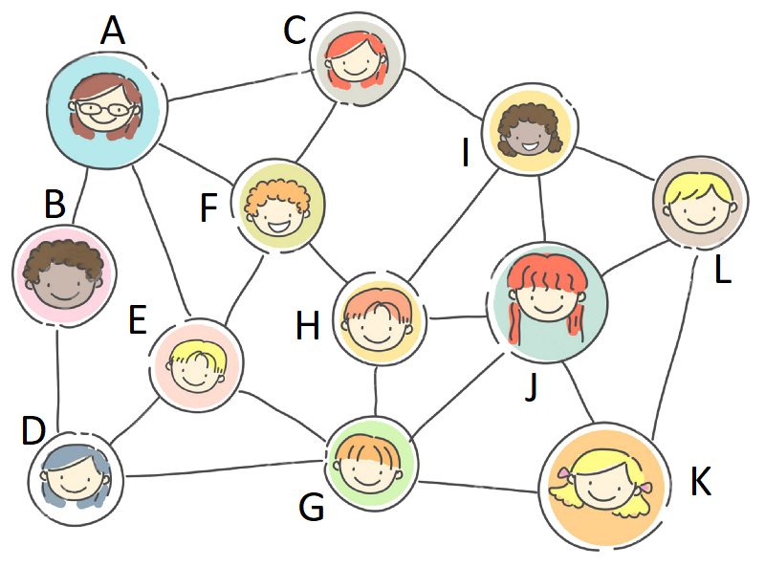
Implementation details

Slide 7
Thank you
Queries ??

